Slide 1
e-Desk
All your solutions in one platform

Slide 2
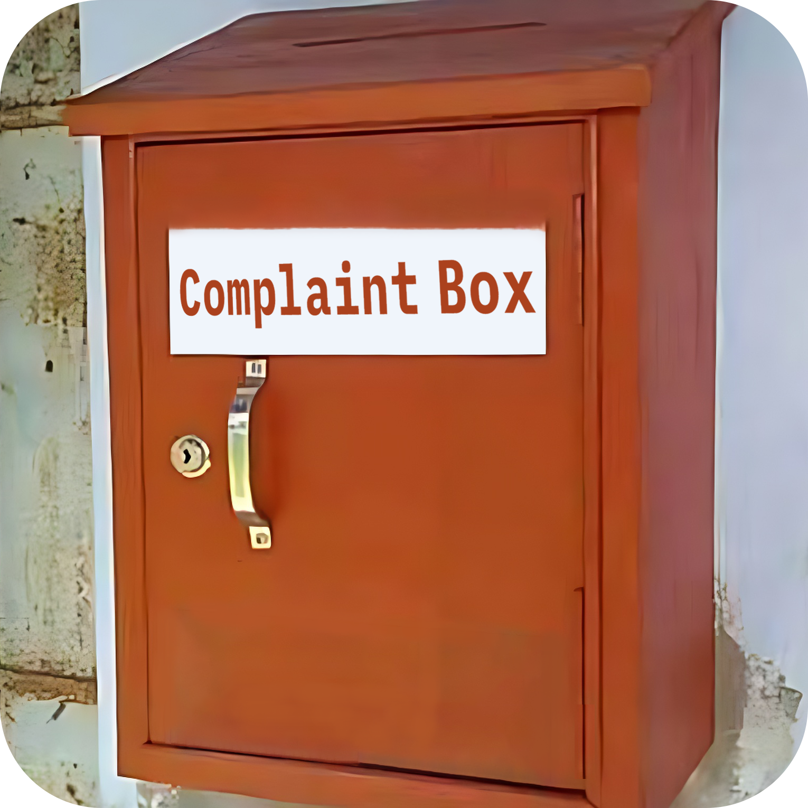
Current Problems
Complexities of Grievances
Lack of Transparency and Accountability
Uncertainty in keeping records
Paper processing

Slide 3
System Overview
add and manage offices
create and manage
office-specific users
Admin
set priority of the grievances
progress monitoring
e-Desk
status management
submit Complaints
User
submit Requests
submit Applications
progress status monitoring

Slide 4

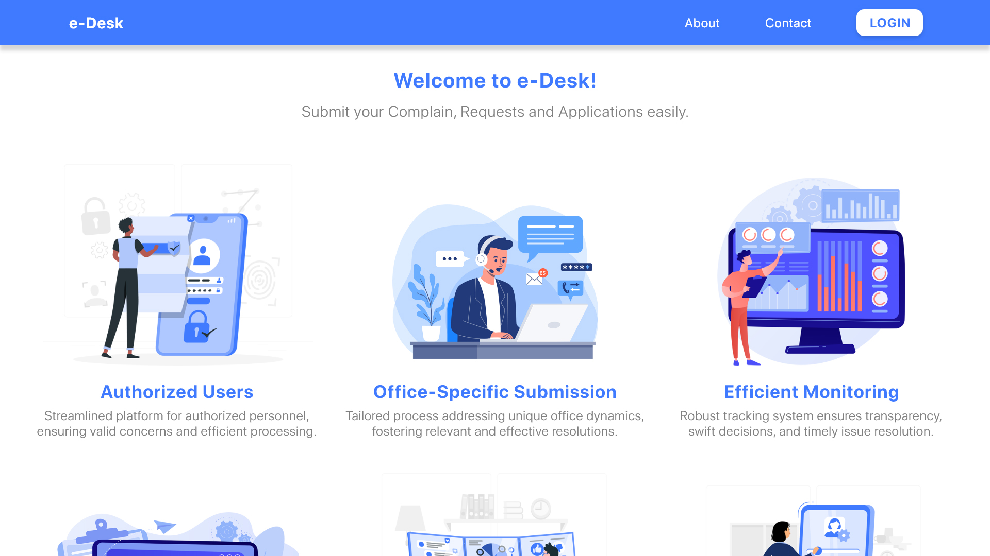
e-Desk Home Page

Slide 5
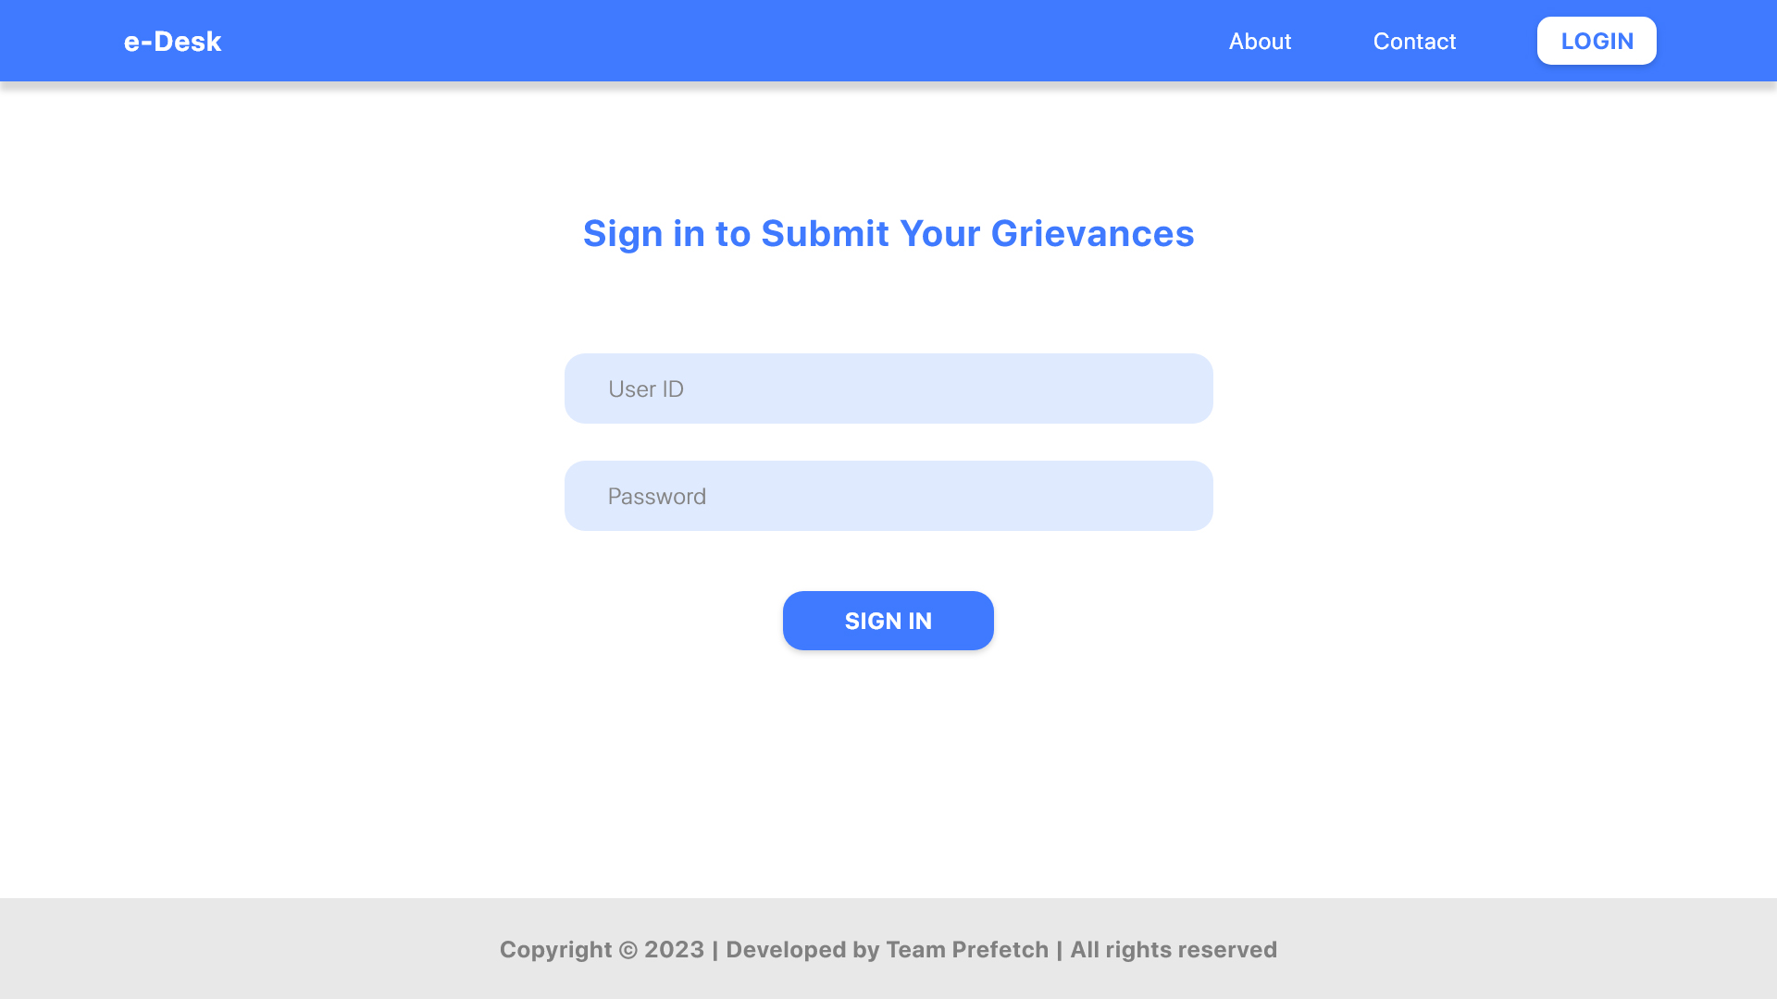
e-Desk Login

Slide 6
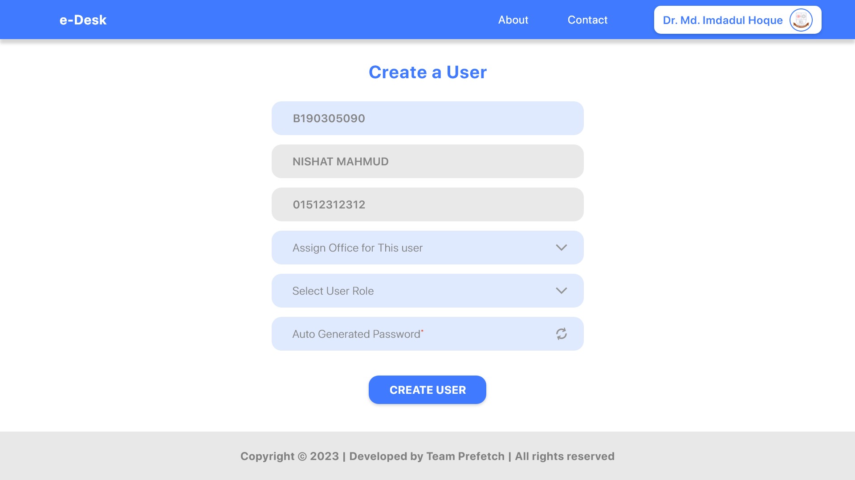
Create a User

Slide 7
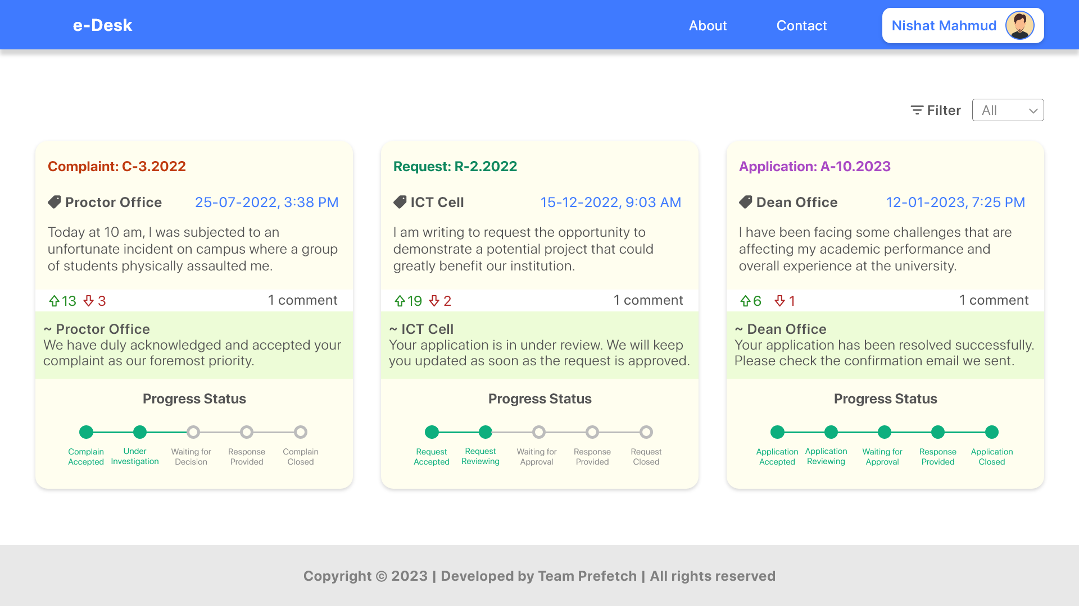
Home (User)

Slide 8
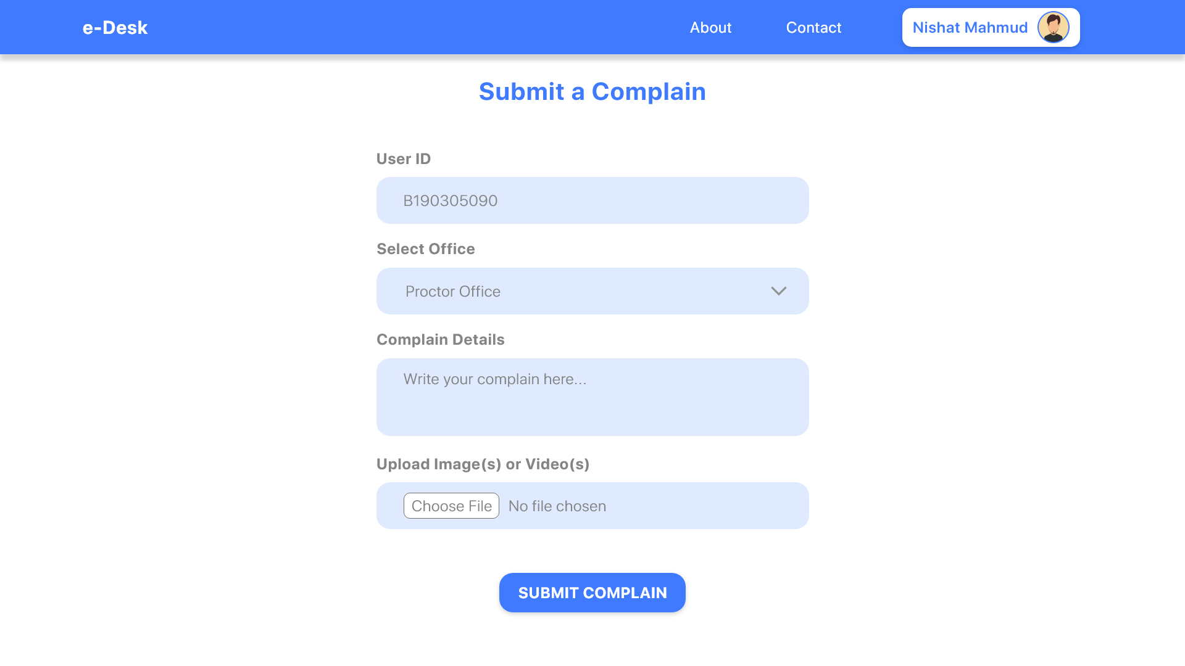
Submit Grievances / Requests / Applications

Slide 9
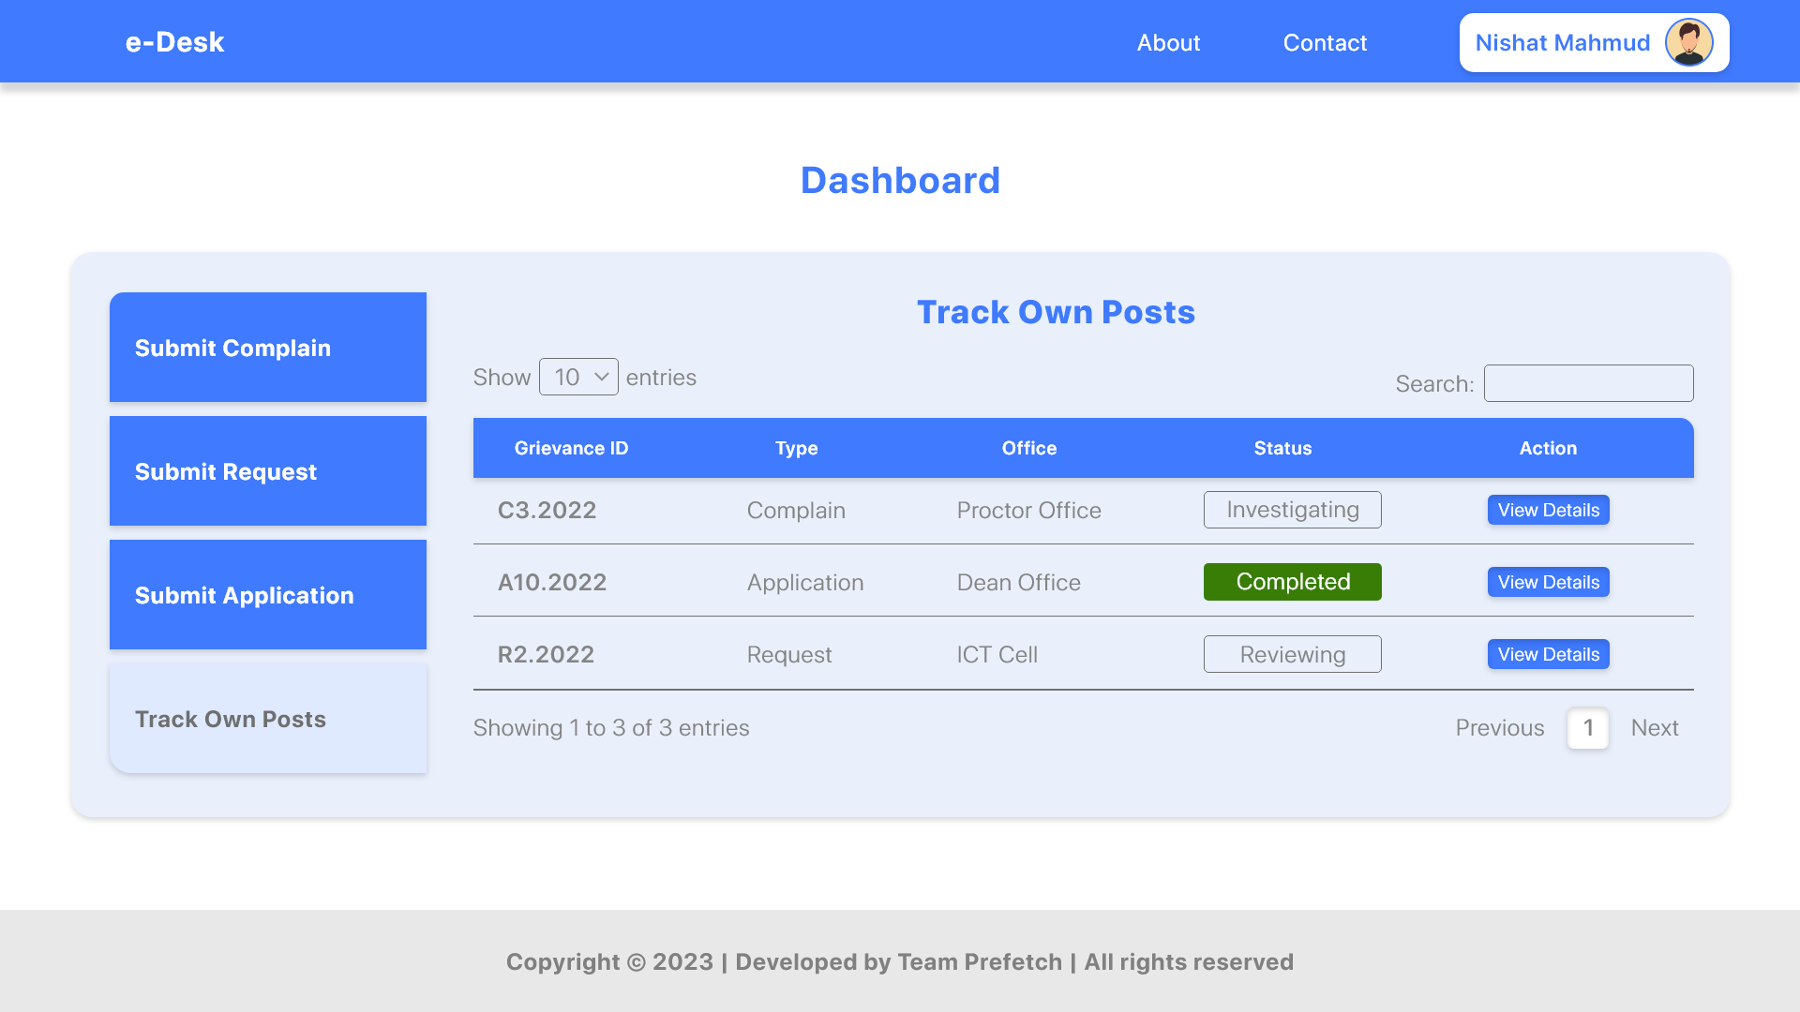
Dashboard (User)

Slide 10
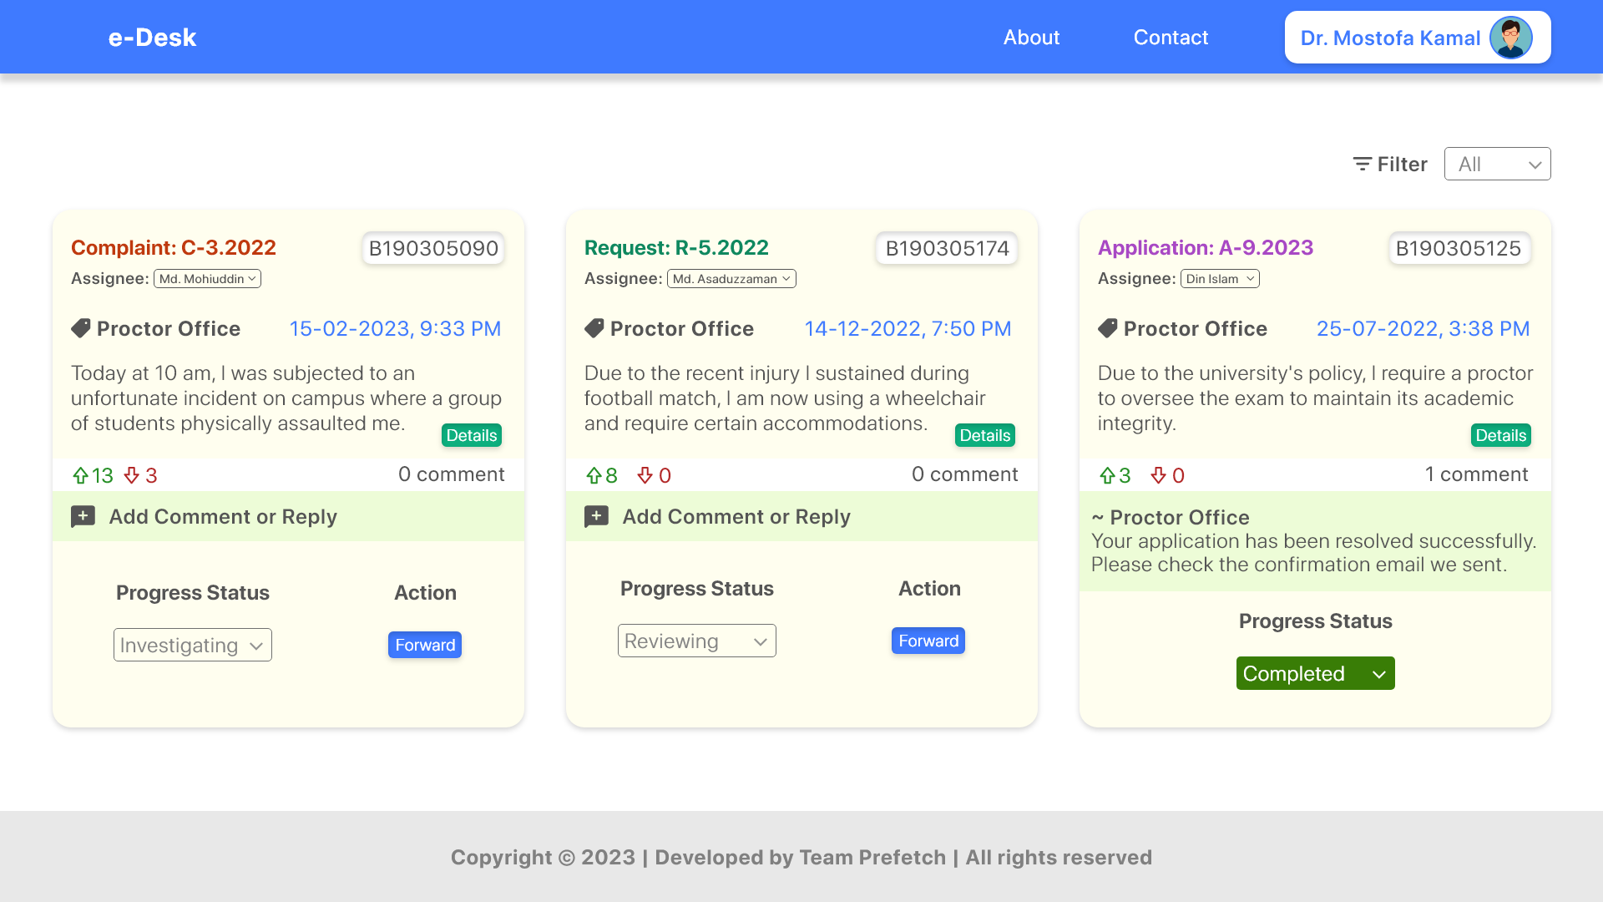
Office-Specific Admin — Newsfeed

Slide 11
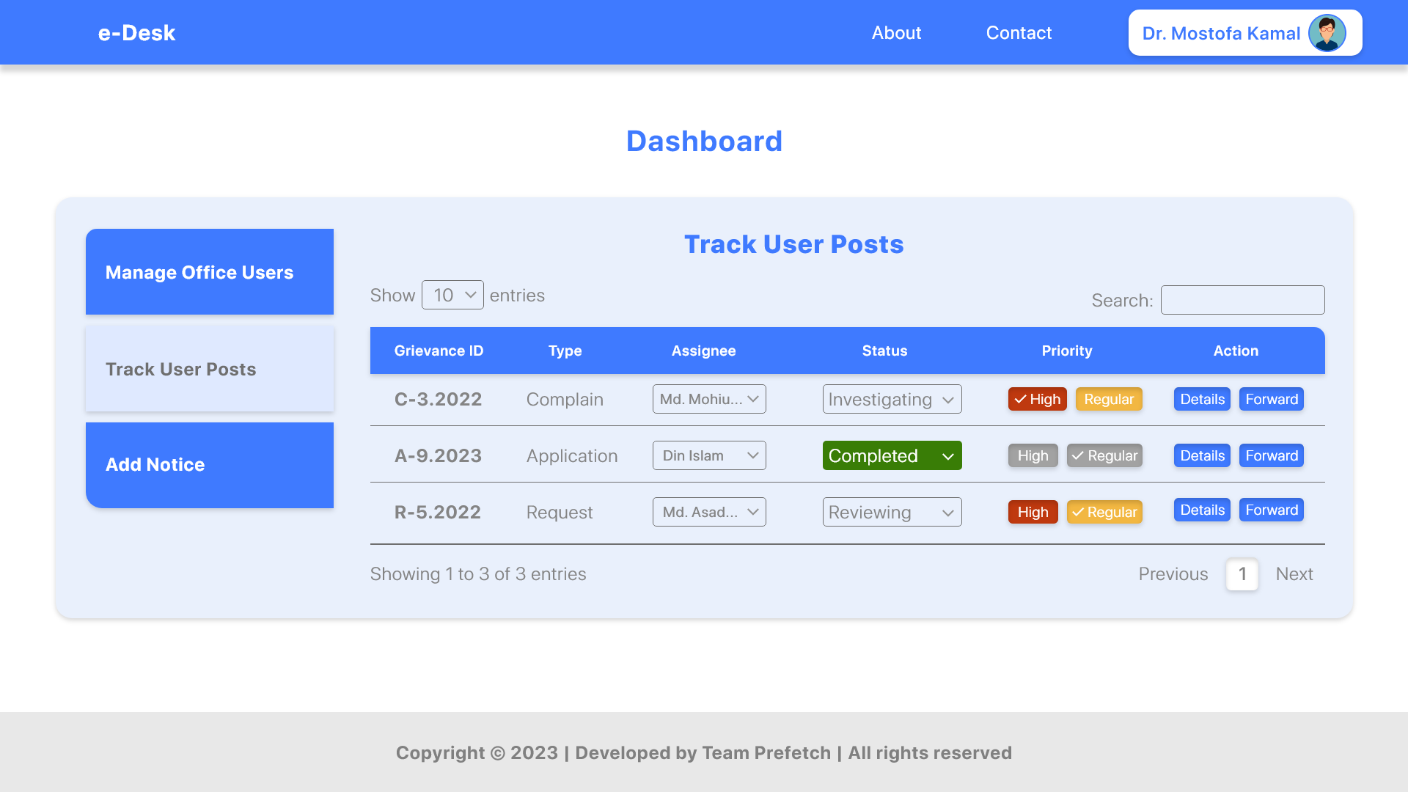
Office-Specific Admin — Dashboard

Slide 12
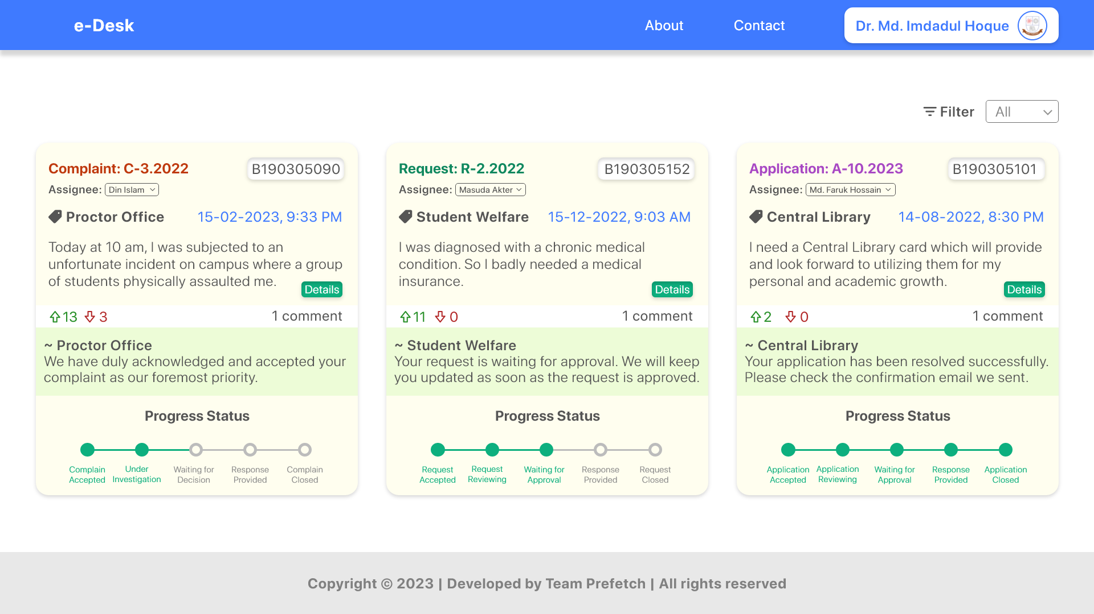
Super Admin — Newsfeed

Slide 13
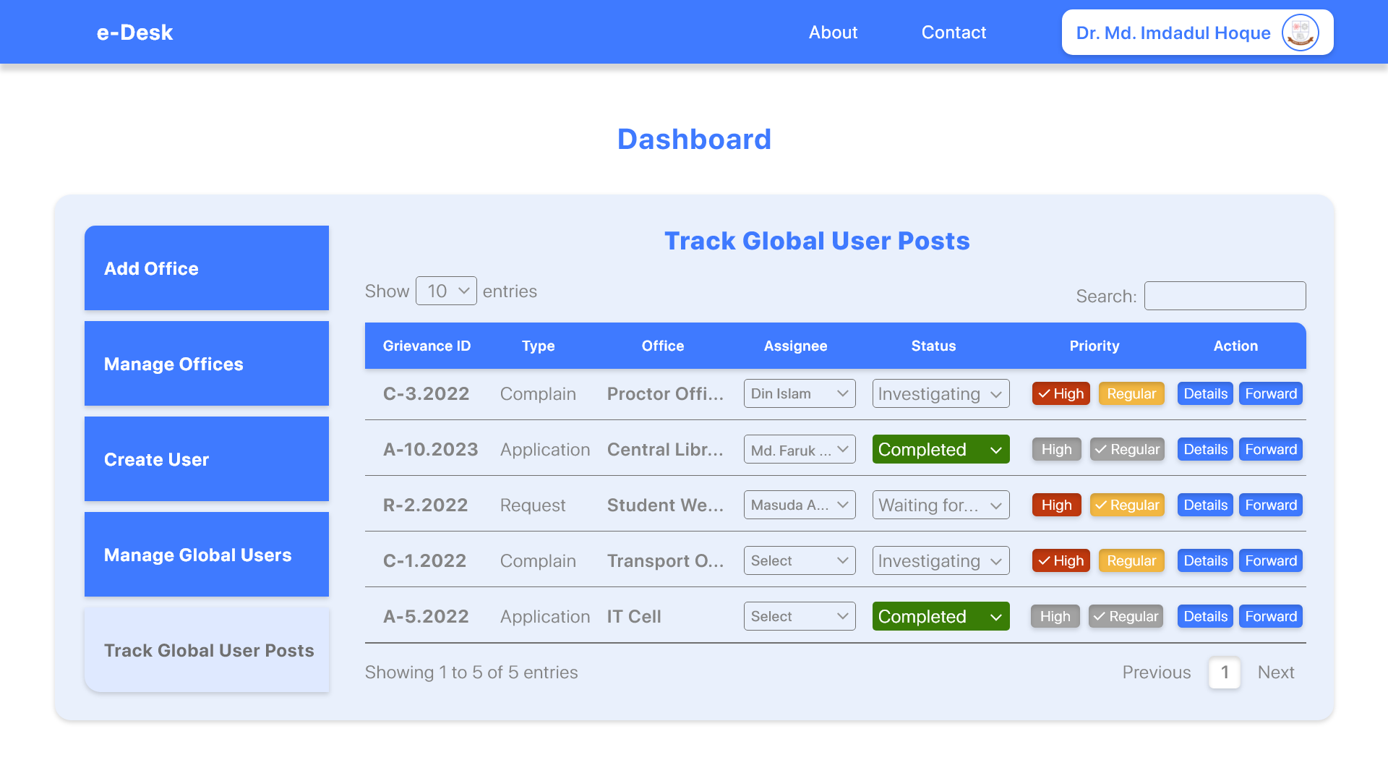
Super Admin — Dashboard

Slide 14
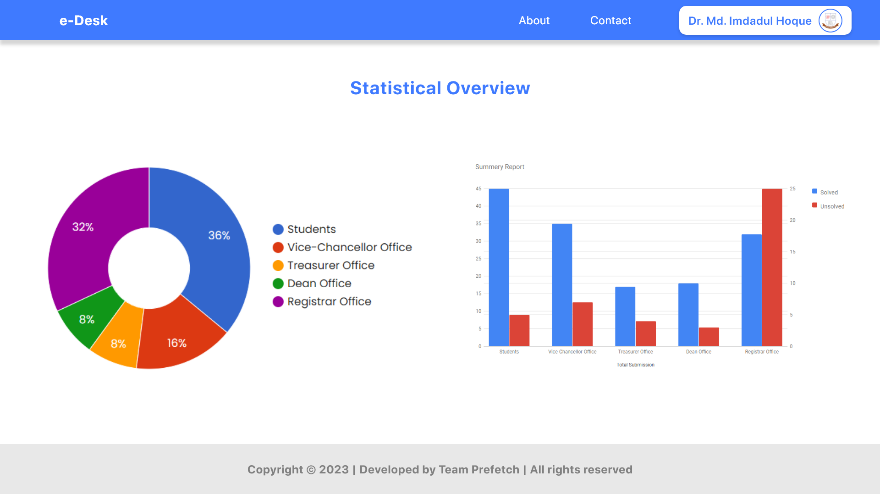
Statistical Overview

Slide 15
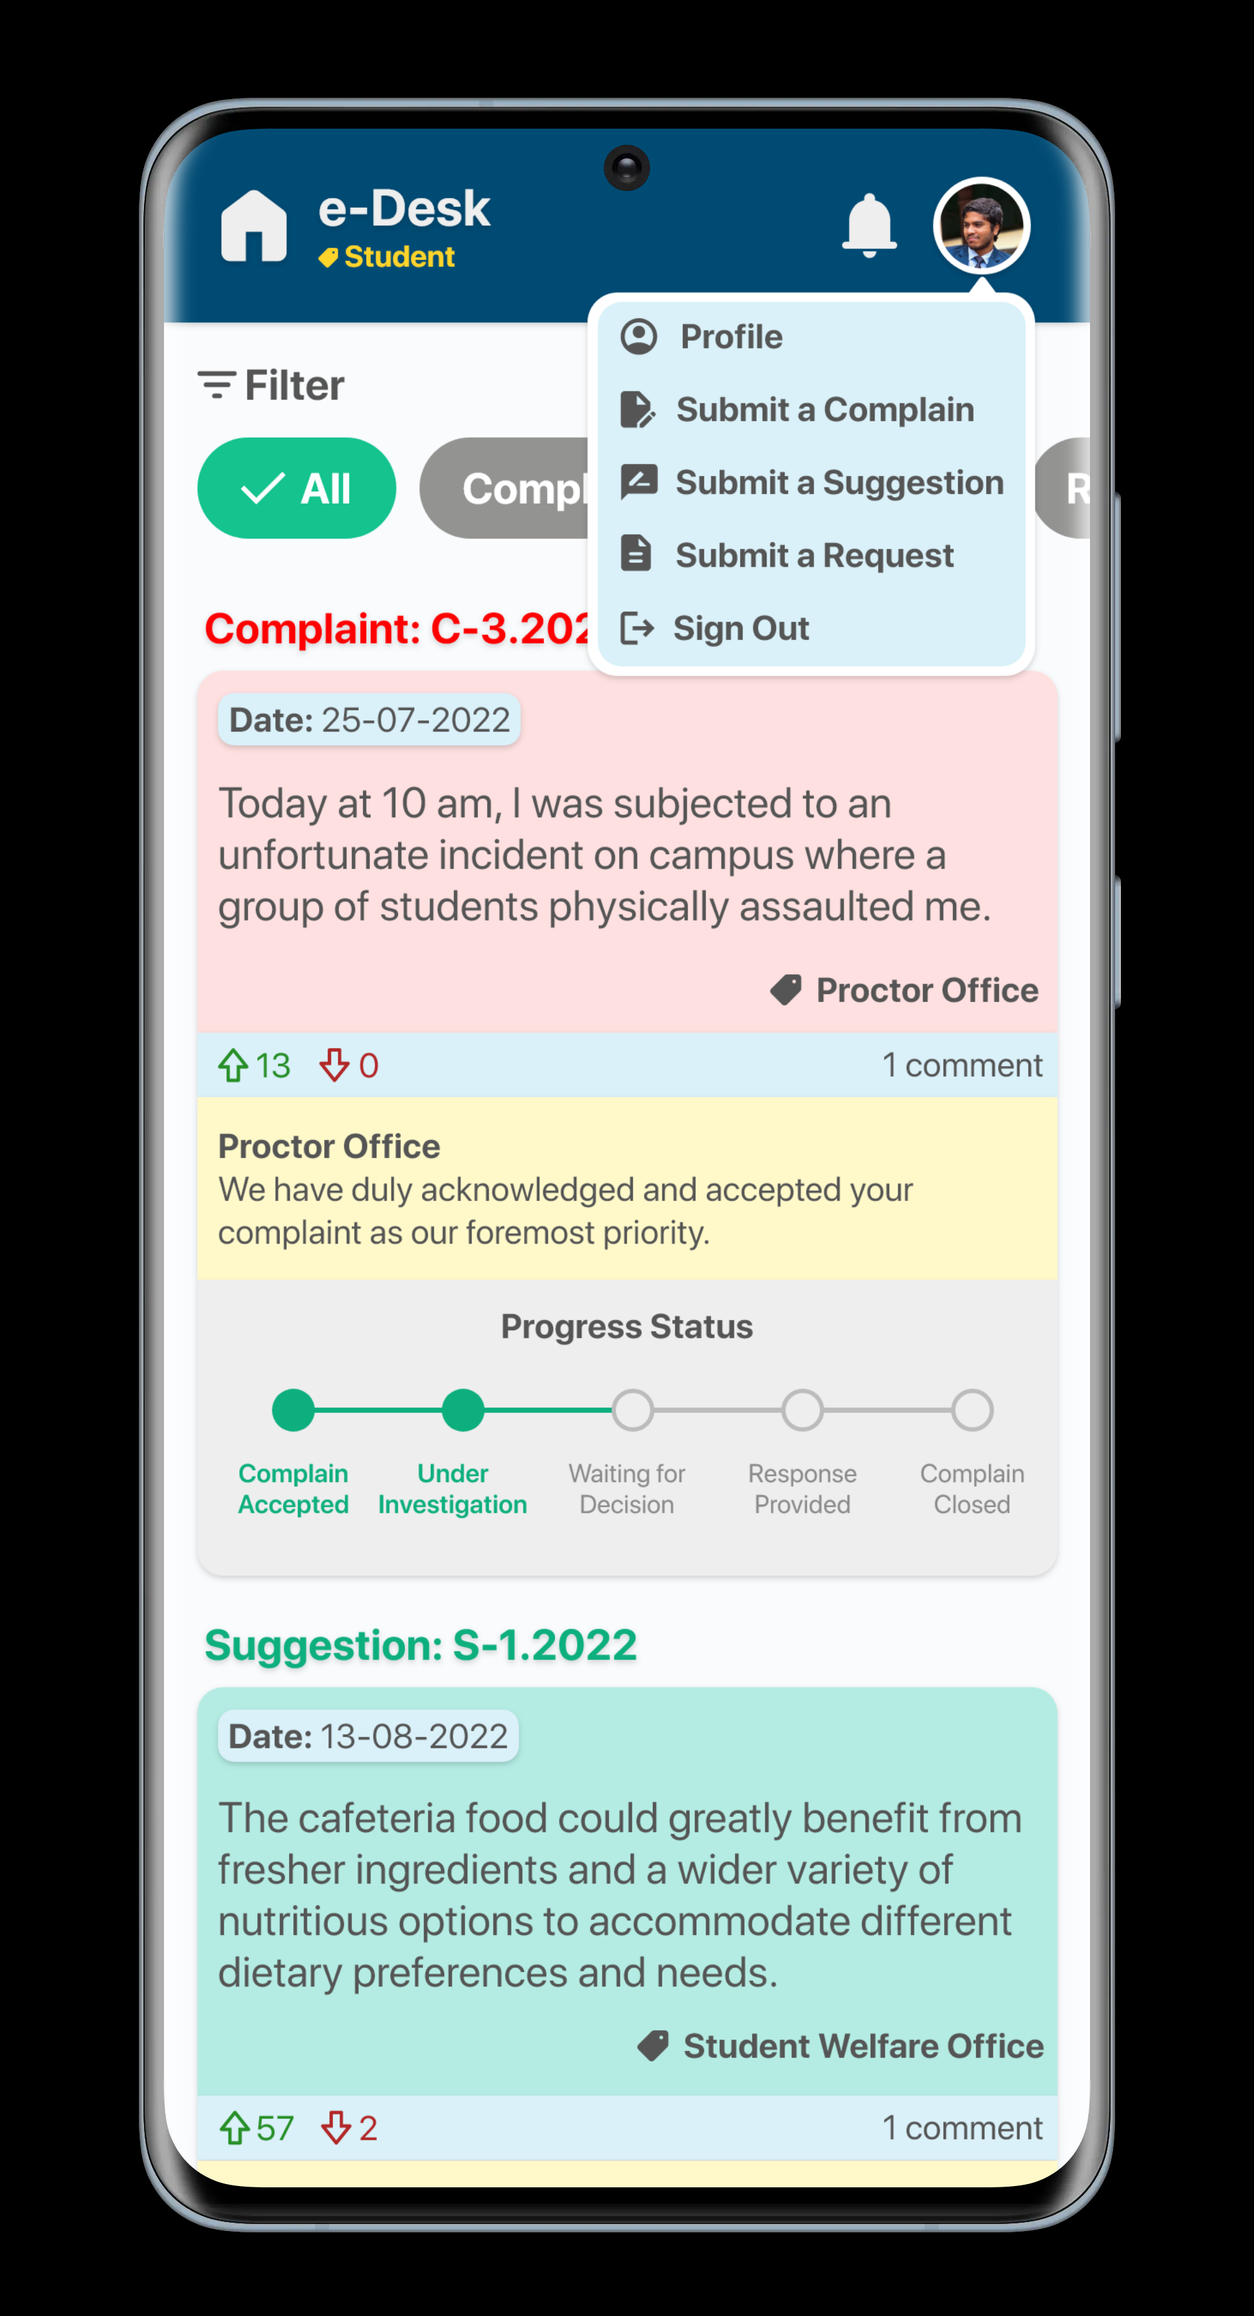
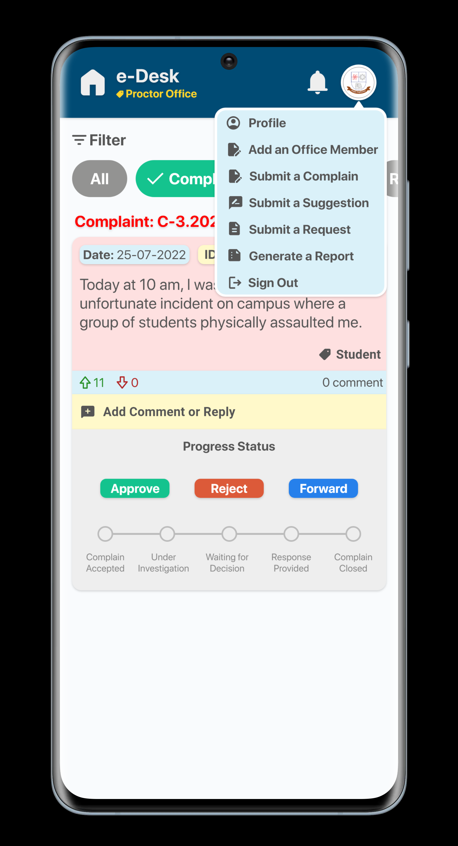
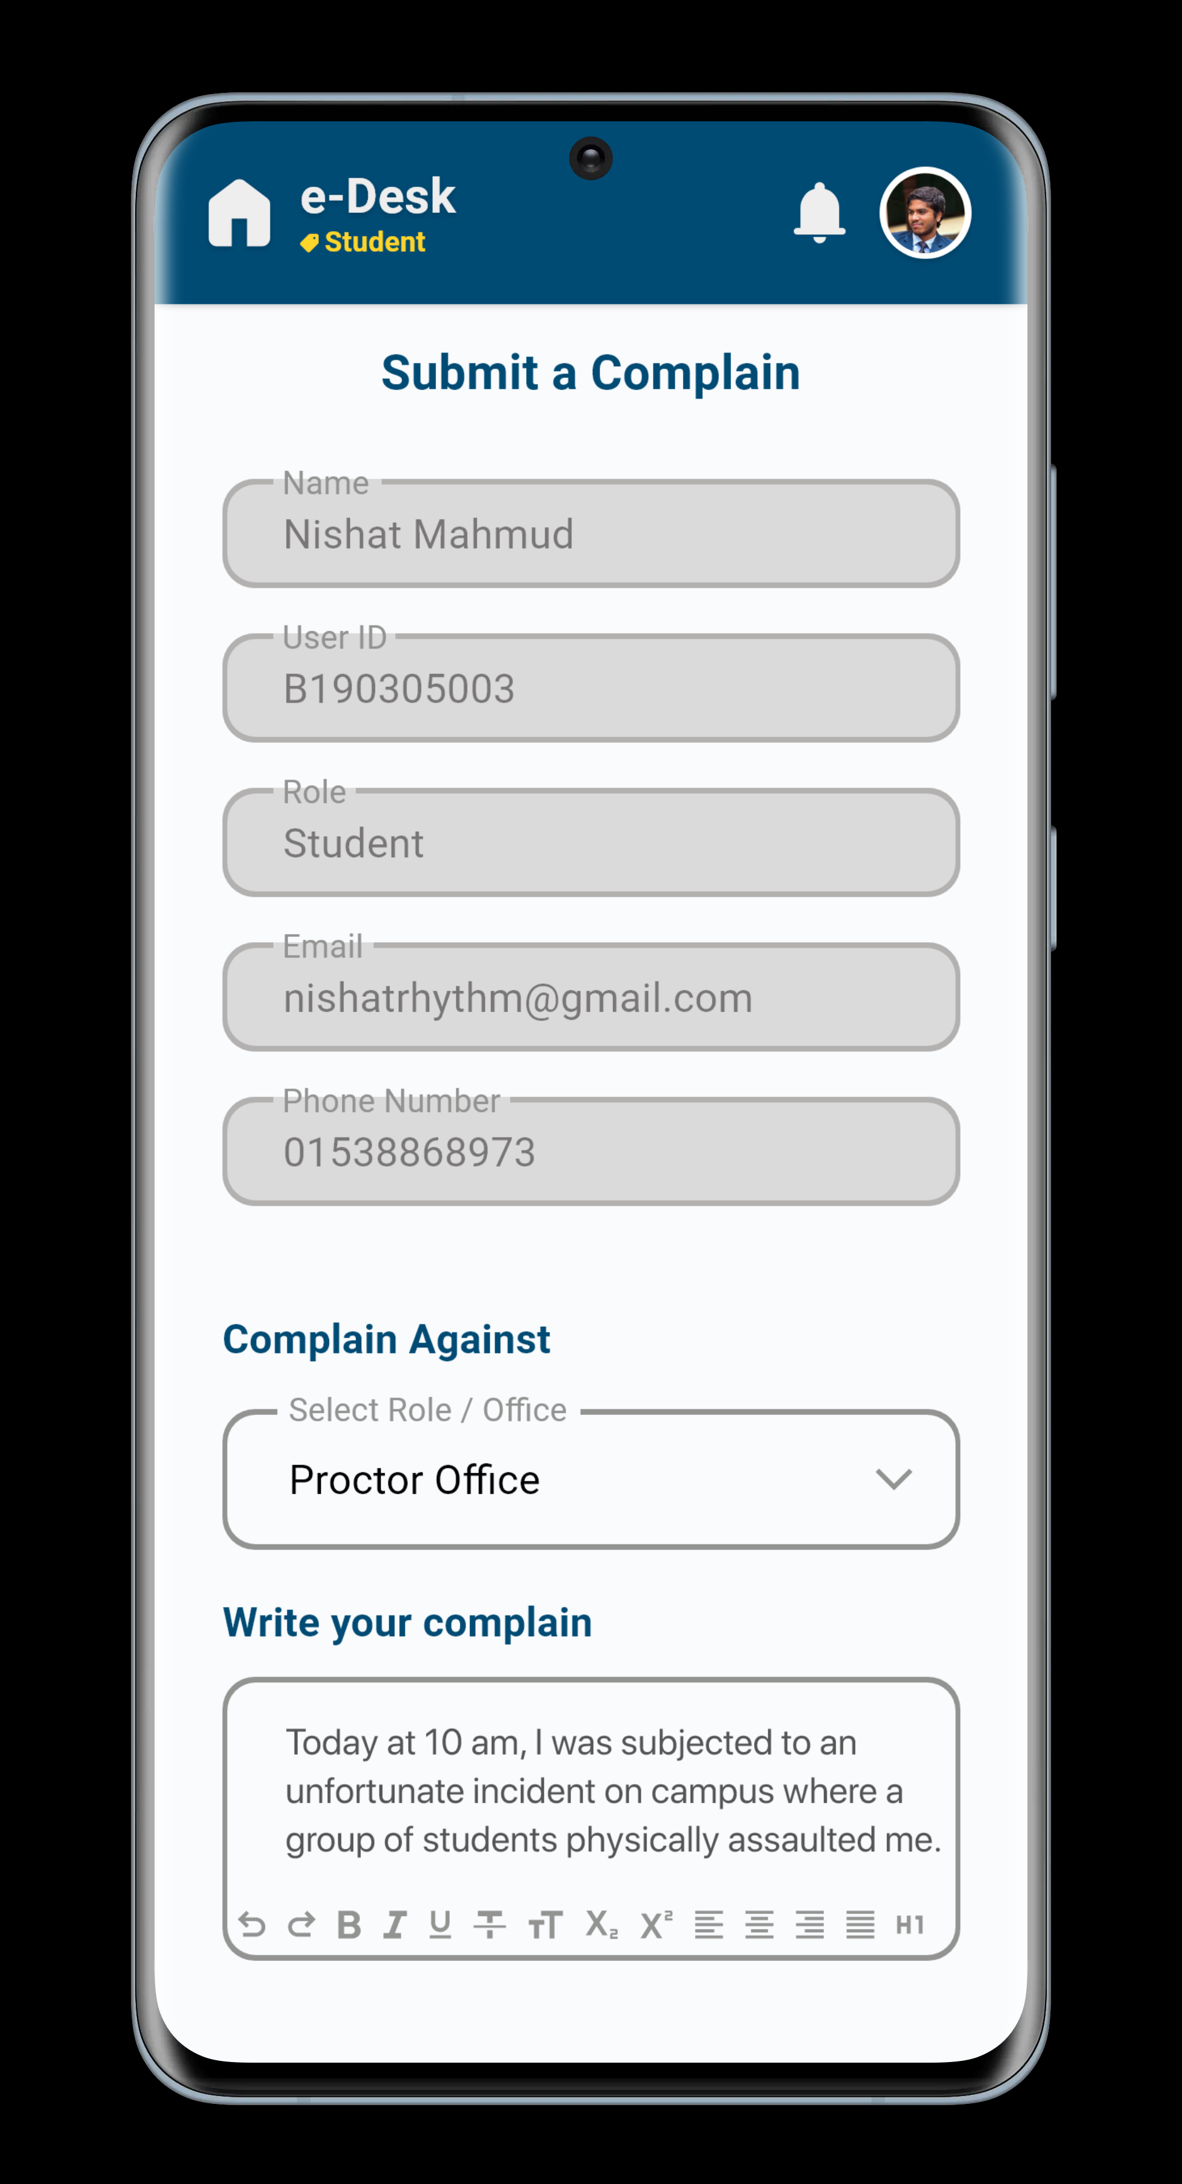
Mobile App (In Development)

Slide 16


Slide 17
Piloting Area (JnU)
2
13
5
3
Departments
Offices
Clubs
Faculties
and Institutes

Slide 18



Business Plan
Software-as-a-Service
Geo Location
Based Ads
Institution
and Organization based Ads

Slide 19
Tools and Technologies
Front-End
Back-End
HTML, CSS, JavaScript
PHP
Database
Tools
MySQL, Azure Cloud
Visual Studio Code, XAMPP, Azure Data Studio

Slide 20



Team Prefetch
NISHAT MAHMUD
nishatrhythm@gmail.com
015 38 86 89 73
MD. WALIUL ISLAM RAYHAN
MD. SAKIBUL ISLAM
mdwaliulislamrayhan@gmail.com
mdsakibulislam736@gmail.com
013 03 09 99 26
015 18 95 11 89

Slide 21
At A Glance
Grievances submission for authorized users
Office-specific grievances submission
Efficient monitoring and decision-making
Digital records for each submission
Transparent authority responses

